Slide 1
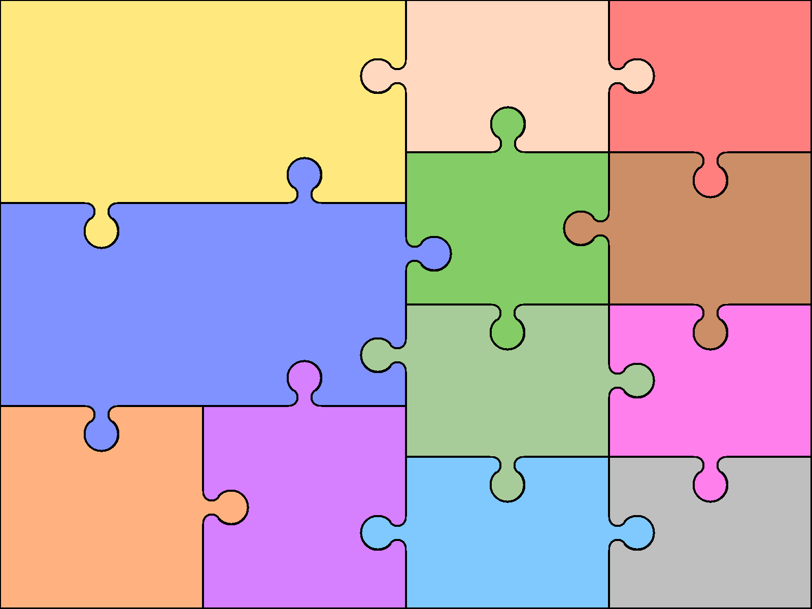
Literacy Monkey Puzzle Peace at last. Our Five Senses – Non Fiction Name writing Labellling Sequencing stories Story maps - Initial sounds.
Expressive Arts and Design Making parrots Making monkeys Masks Junk modelling houses Play dough creatures. Printing Charanga Music
Outdoor Learning Weekly session in Forest Area. Outdoor crafts eg: stick skeletons Making houses form natural materials.
PSED My family How to care for others Friendships Feelings Safe secrets Respect
.
Modern Foreign Languages N/ A
Number .
Shape and Space
.
Bluebells.
Autumn –Ourselves, Senses & Food
I.C.T
Loggin g on.
Mouse control
Fine Motor (Physical) Dough disco Pencil control sheets Sand writing Mark making cards Lolly stick shape cards Playdough moulding Threading Modelling.
Understanding the World .Growing up and how we change Body parts. Healthy eating Where we live The local area. Life in the jungle.
British Values Seal: (Change) –
P.E .

