Slide 1
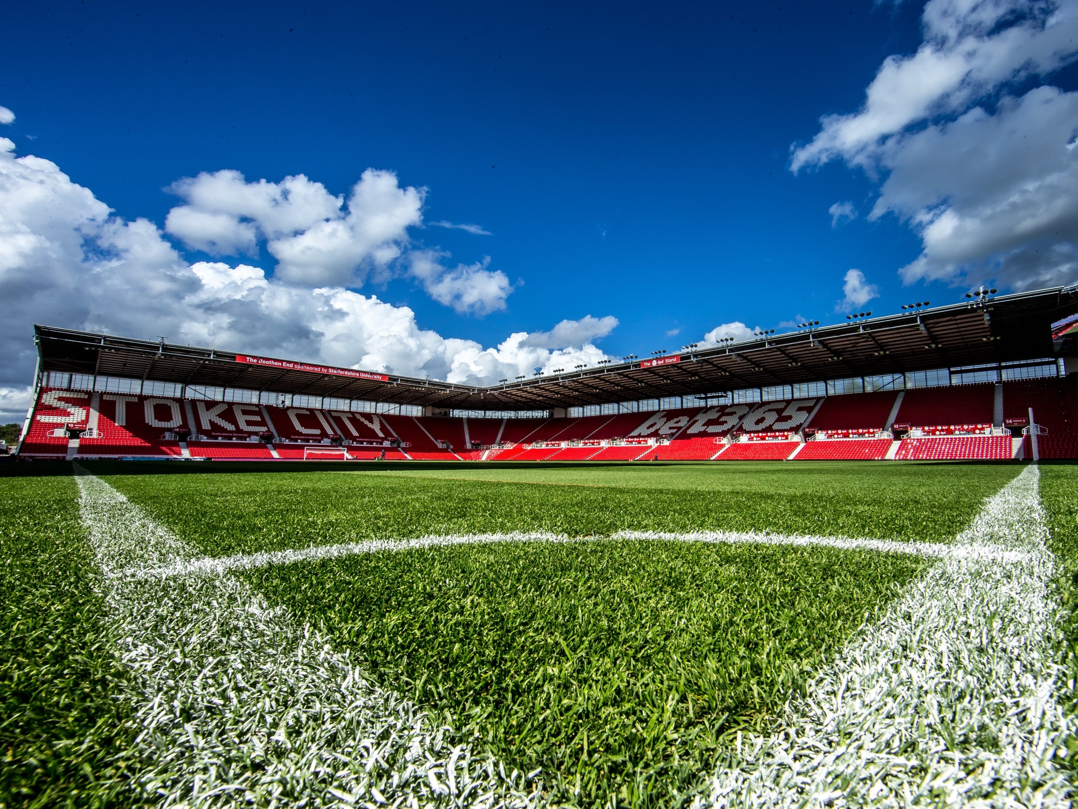
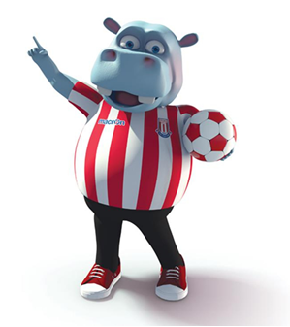
POTTERMUS ACTIVE HOMEWORK TASK ‘Agility’
SLALOM CHALLENGE:
How many times can you run around the slalom course in 30 seconds?
Extra challenges: increase time, space the cones out further, change the action e.g. hopping, skipping, galloping, jumping, play against your friends and family, practice to improve your personal best.
Equipment: 4 cones, timer

Slide 2
POTTERMUS ACTIVE HOMEWORK TASK ‘Throwing’
HIT THE CONES CHALLENGE:
Using a rolling action hit the cones in order of nearest to furthest away. If you miss, run to collect ball and bring back to the start. Once the nearest cone has been hit bring the cone back to the start position. How far can you get up the cone ladder in 30 seconds.
Extra challenges: increase time, increase the distance of cones, size of the ball, play against your friends and family, practice to improve your personal best.
Equipment: 4 cones, ball, timer
start

Slide 3
POTTERMUS ACTIVE HOMEWORK TASK ‘Balance’
TIGHTROPE CHALLENGE:
Travel along a skipping rope without falling to either side for 30 seconds? If balance is lost record time of fall. Use a bean bag on your head to make it harder
Extra challenges: change how you travel e.g. hop on one leg, change shape of the rope, see how quickly you can do it, practice to improve your personal best.
Equipment: skipping rope, bean bag, timer
Layout 1
Layout 2

Slide 4
POTTERMUS ACTIVE HOMEWORK TASK ‘Co-ordination’
BEANBAG THROW CHALLENGE:
Spread the cones out upside down away from the start. Throw the bean bag into one cone and collect. Time how long it takes to complete all 4 cones. Run and bring the bean bag back if you miss and try again.
Extra challenges: increase time, increase distance of throw, play against your friends and family, practice to improve your personal best.
Equipment: 4 cones, beanbag, timer
start

Slide 5
POTTERMUS ACTIVE HOMEWORK TASK ‘Running’
RUN AND COLLECT CHALLENGE:
Run to the 1st cone, collect and bring back to the start, then the 2nd cone and return and then the 3rd cone and then the 4th and stop the timer.
Extra challenges: increase time, increase the distance of cones, change action e.g. side step, play against your friends and family, practice to improve your personal best.
Equipment: 4 cones, timer
start

Slide 6
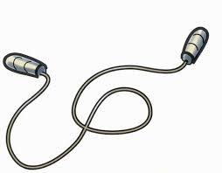
POTTERMUS ACTIVE HOMEWORK TASK ‘Jumping’
SKIPPING CHALLENGE:
How many skips can you do in 30 seconds with a skipping rope.
Extra challenges: increase or decrease time, skip up and down an area, play against your friends and family, practice to improve your personal best.
Equipment: Skipping rope, timer

Slide 7
POTTERMUS ACTIVE HOMEWORK TASK ‘Kicking’
DRIBBLING CHALLENGE:
Dribble the ball with your feet in and out of each of the cones. Repeat 3 times and time it. Aim to improve your time with practice.
Extra challenges: increase or decrease the distance of cones, try to use right foot and then left foot, play against your friends and family, practice to improve your personal best.
Equipment: 4 cones, timer
start

Slide 8
POTTERMUS ACTIVE HOMEWORK TASK ‘Catching’
CATCHING CHALLENGE:
Complete a 2 handed catch, 1 handed, opposite hand, left hand to right hand then right hand to left and finish with a clap. Extend to ball going above head for each throw.
Extra challenges: increase time, increase number of catches, change the size of ball, play against your friends and family, practice to improve your personal best.
Equipment: Ball or bean bag

Slide 9
POTTERMUS ACTIVE HOMEWORK TASK ‘Agility’
BEANBAG ON THE MOVE CHALLENGE:
Start with a bean bag on one cone. Move the beanbag to the opposite cone and return back to the start. How many times can you do this in 30 seconds? Use side steps, hopping, jumping with 2 feet or think of your own actions.
Extra challenges: increase time, increase the distance of the cones, play against your friends and family, practice to improve your personal best.
Equipment: beanbag, cones, timer
start

Slide 10
POTTERMUS ACTIVE HOMEWORK TASK ‘Throwing’
OVERARM CHALLENGE:
Throw a small ball one handed onto the floor, using an overarm action and catch it in a upturned cone. Repeat several times and then catch using two hands and then one hand.
Extra challenges: throw overarm to a partner, throw against a wall, play catch your friends and family, practice to improve your personal best.
Equipment: ball, cone

Slide 11
POTTERMUS ACTIVE HOMEWORK TASK ‘Balance’
BEAN BAG BALANCE CHALLENGE:
Place a bean bag on your head and move in and out of the cones keeping the bean bag on your head. If the bean bag falls off, you must go back to the start. Record your finish time.
Extra challenges: increase time, decrease space between of cones, play against your friends and family, practice to improve your personal best.
Equipment: 4 cones, beanbag, timer
start

Slide 12
POTTERMUS ACTIVE HOMEWORK TASK ‘Co-ordination’
FIGURE OF 8 CHALLENGE:
Holding a ball in your hands, how many times can you create the figure of 8 motion around and in between your legs in 30 seconds? If the ball is dropped you must start again.
Extra challenges: increase time, move the ball around your waist, head and knees, play against your friends and family, practice to improve your personal best.
Equipment: ball, timer

Slide 13
POTTERMUS ACTIVE HOMEWORK TASK ‘Running’
SQUARE LAP CHALLENGE:
How many times can you run around the outside 4 cones and back to the start in 2 minutes. Pace yourself so you can keep going for the whole 2 minutes.
Extra challenges: increase or decrease time, space the cones out further, change the shape of the course, run with your friends and family, practice to improve your personal best.
Equipment: 4 cones, timer
start

Slide 14
POTTERMUS ACTIVE HOMEWORK TASK ‘Jumping’
DOUBLE JUMP CHALLENGE:
Jump with 2 feet over each of the cones and then run back down the side of the cones to the start and repeat 5 times. Use your arms to get extra height and bend knees when you land. Time how long it takes you to do it 5 times
Extra challenges: increase the number of times, change how you jump over the cones, play against your friends and family, practice to improve your personal best.
Equipment: 4 cones, timer
start

Slide 15
POTTERMUS ACTIVE HOMEWORK TASK ‘Kicking’
KEEP IT UP CHALLENGE:
How many times can you kick the ball up without it stopping. Kick it in the air and let it bounce at first before kicking again and then try to kick it without it dropping on the floor.
Extra challenges: use your thigh, shoulder, chest, head to keep the ball off the ground, play with your friends and family, practice to improve your personal best.
Equipment: ball

Slide 16
POTTERMUS ACTIVE HOMEWORK TASK ‘Catching’
BOUNCE CATCH CHALLENGE:
How many times can you bounce and catch a ball in 30 seconds? Try a 2 handed bounce and catch first, then move to one hand bounce and catch
Extra challenges: increase time, change size of ball, play against your friends and family, practice to improve your personal best.
Equipment: cone, ball, timer

Slide 17
POTTERMUS ACTIVE HOMEWORK TASK ‘Agility’
COLOUR TAP CHALLENGE:
How many times can you touch each of the 4 coloured cones in 30 seconds? You have to go back to the start position (X) after each tap
Extra challenges: increase time, space the cones out further, change the action e.g. hopping, jumping, play against your friends and family, practice to improve your personal best.
Equipment: 4 cones, timer
X

Slide 18
POTTERMUS ACTIVE HOMEWORK TASK ‘Throwing’
UNDERARM CHALLENGE:
Underarm throw the tennis ball into an upturned cone and repeat with all cones. Put the cones randomly around the area.
Extra challenges: space the cones out further, have a friend to catch the ball at each cone, larger ball, play against your friends and family, practice to improve your personal best.
Equipment: 4 cones, ball, timer
start

Slide 19
POTTERMUS ACTIVE HOMEWORK TASK ‘Balance’
HOLD IT CHALLENGE:
How long can you stand on one leg while balancing a ball on one hand with arms outstretched? Decide a target time e.g. 60 seconds
Extra challenges: hold a ball in each hand, try balancing on the other foot, change time limit, play against your friends and family, practice to improve your personal best.
Equipment: 2 balls, timer

Slide 20
POTTERMUS ACTIVE HOMEWORK TASK ‘Co-ordination’
HOP SCOTCH CHALLENGE:
How many times can you hop, skip and jump from cone to cone in 30 seconds? Cone must be touched with your hand.
Extra challenges: increase time, increase distance, play against your friends and family, practice to improve your personal best.
Equipment: cones, timer

Slide 21
POTTERMUS ACTIVE HOMEWORK TASK ‘Running’
MEMORY CHALLENGE:
Run to the colour cones called out by a friend or family member e.g. blue – red. You must go back to the start after each colour and remember the order
Extra challenges: increase distance, call 3 or 4 colours at a time , play against your friends and family, practice to improve your personal best.
Equipment: cones, timer
start

Slide 22
POTTERMUS ACTIVE HOMEWORK TASK ‘Jumping’
JUMP THE RIVER CHALLENGE:
Lay the skipping rope out at an angle, jump from a standing position with 2 feet together over it. Start at the small end, then move up the straight line to make it harder.
Extra challenges: increase distance, change shape of the ‘river’, play against your friends and family, practice to improve your personal best.
Equipment: skipping rope
‘river’

Slide 23
POTTERMUS ACTIVE HOMEWORK TASK ‘Kicking’
CAN YOU KICK IT CHALLENGE:
Using a kicking action hit the cones in order of nearest to furthest away. If you miss, run to collect ball and bring back to the start. Once the nearest cone has been hit bring the cone back to the start position. How far can you get up the cone ladder in 30 seconds.
Extra challenges: increase time, increase the distance of cones, size of the ball, play against your friends and family, practice to improve your personal best.
Equipment: 4 cones, ball, timer
start

Slide 24
POTTERMUS ACTIVE HOMEWORK TASK ‘Catching’
SPEED CATCH CHALLENGE:
How many times can you catch a ball in 30 seconds –either throw to yourself, with a partner or against the wall?
Extra challenges: increase time, increase distance from friend or wall, increase height when throwing to yourself, play against your friends and family, practice to improve your personal best.
Equipment: ball, timer

Slide 25
POTTERMUS ACTIVE HOMEWORK BAG
THE CHALLENGE:
Stoke City’s mascot Pottermus is challenging you to take part in some physical activity at home all week, using this active homework bag
You can play on your own or with your family or friends
Use the equipment in the bag to complete some or all of the challenges
Make sure you are in a safe space and warm up before starting
Parents/guardians – write down in the book how you used the equipment and include drawings or photographs, then return back to school with the bag
*Extra Challenge*
Can you think of different physical challenges with the equipment?

Slide 26
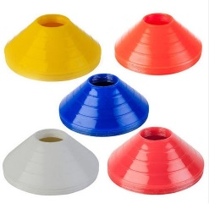
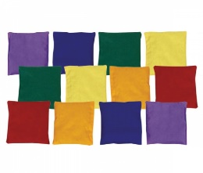
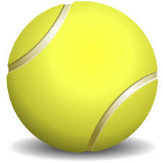
POTTERMUS ACTIVE HOMEWORK BAG
CONTENTS:
Tennis ball
Skipping rope
4 different coloured cones
Small ball
Bean bag

Slide 27
POTTERMUS ACTIVE HOMEWORK BAG
FMS:
Agility
Throwing
Balance
Co-ordination
Running
Jumping
Kicking
Catching
BAG 1 | BAG 2 | BAG 3
Slalom | Bean on the move | Colour tap
Hit cones | Overarm | Underarm
Tight rope | Bean bag balance | Hold it
Bean bag throw | Figure of 8 | Hopscotch
Run and collect | Square lap | Memory
Skipping | Double jump | Jump the river
Dribbling | Keep it up | Can you kick it
Catching | Bounce catch | Speed catch

